Slide 1

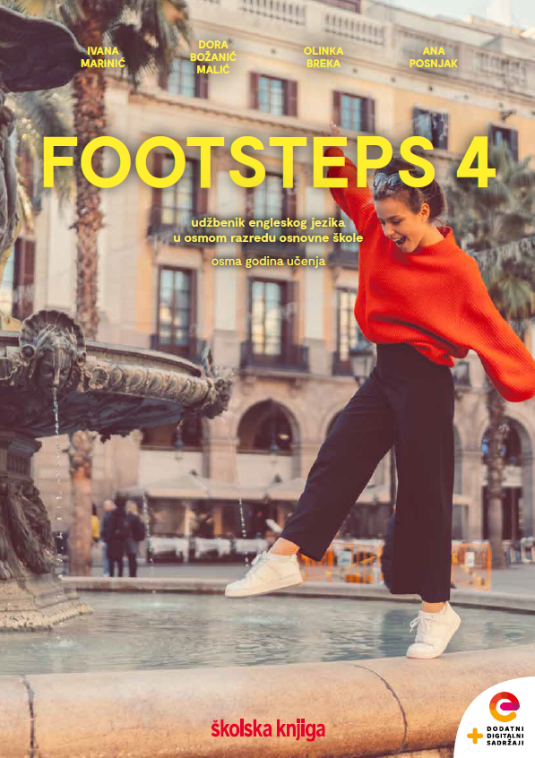

UNIT 1; All too human
Lesson 7; Fly, Jonathan!

Slide 2
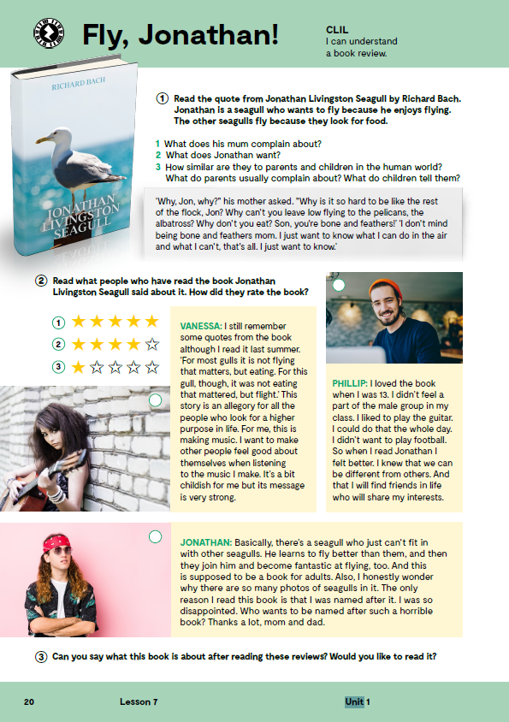
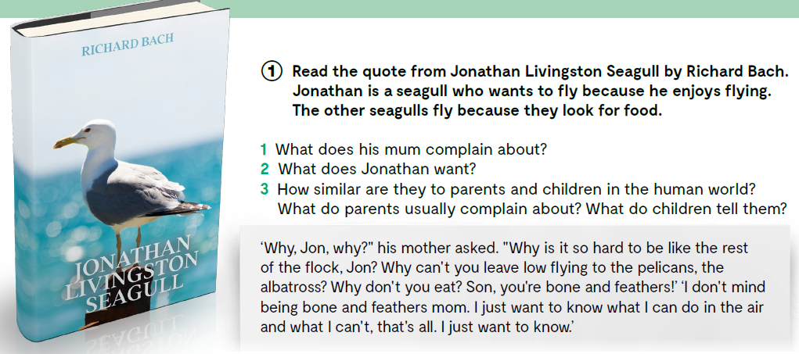
Read the quote from Jonathan Livingston Seagull by Richard Bach. The book is about being different. Jonathan is a seagull who flies because he enjoys flying while other “normal“ seagulls fly because they look for food.
Is it OK to be different?
What does his mum complain about?
What does Jonathan want?
How similar are they to parents and children in the human world?
What do parents usually complain about?
What do children tell them?

Slide 3

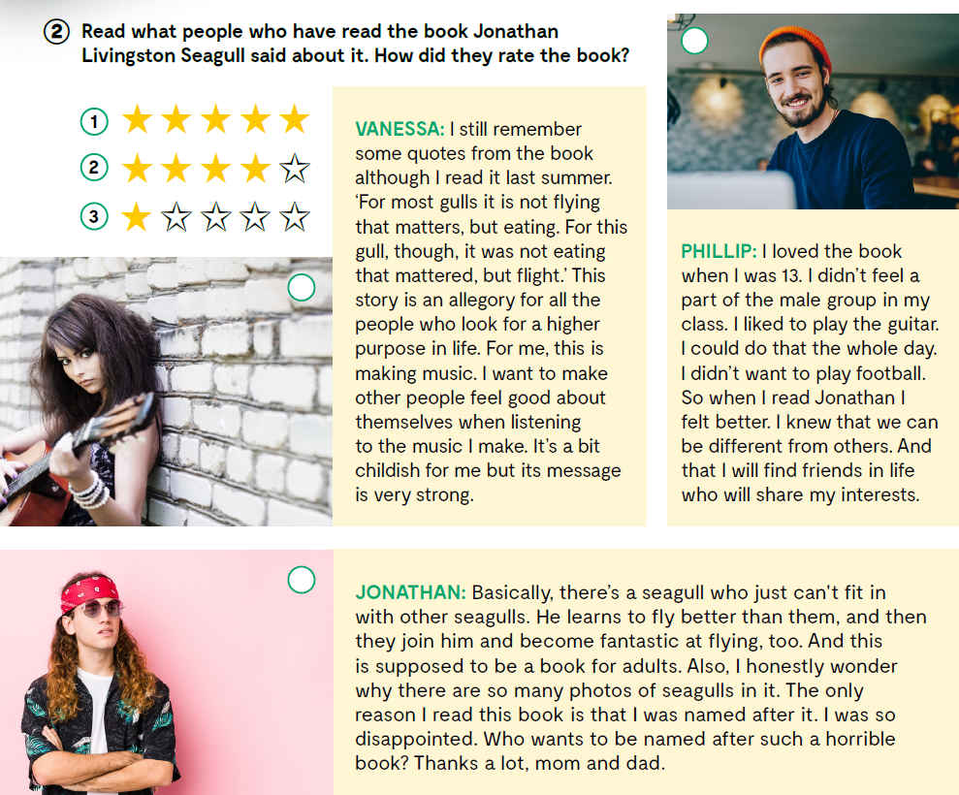
1
Read what people who have read the book Jonathan Livingston Seagull said about it. How did they rate the book?
2
3
Can you say what this book is about after reading these reviews?
Would you like to read it?

Slide 4

Open the following link and then click on LEARN MORE! https://www.e-sfera.hr/dodatni-digitalni-sadrzaji/e0a5b6e8-b5a3-4abe-8aa9-26c5f59af956/
What is a good review?
Have you ever given a star or five to a film you saw? Or clicked the like button on Instagram? If yes, you have already given the briefest of reviews. Reviews are there to show others what we do or do not like. Since more and more reviews are online and public, it is useful to learn some basic steps to writing a good one. A review does not have to be long – just honest, useful, and as kind as possible.
Here are some basic tips on how to write a review.
Write your own review of something you bought, or a place you visited.
You can also: 1) Check reviews for your favourite film, TV series, game, book, or product. Do reviewers agree with you – or you with them? Find examples of good reviews online. Try to see if they follow all five rules. 2) Find random reviews online. You can use Rotten Tomatoes for films, Goodreads for books, Google for products and services, or any other platform you like. Are they written well or poorly?

Slide 5
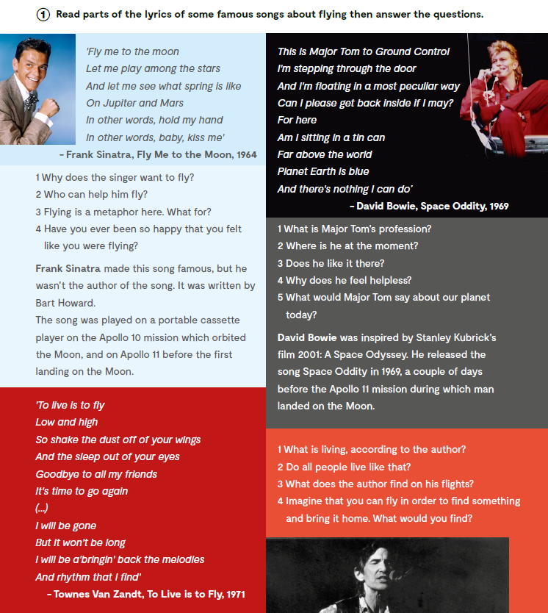
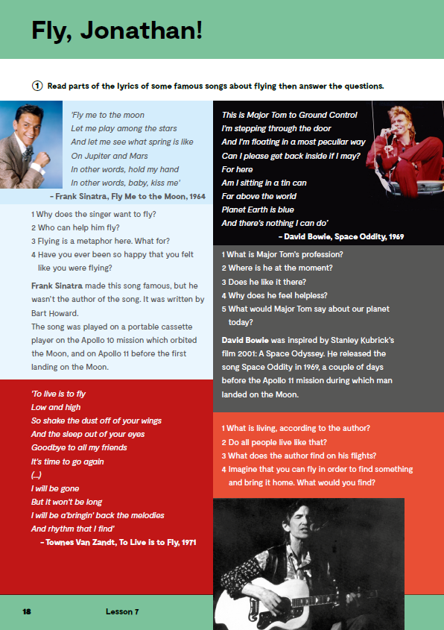
Read parts of the lyrics of some famous songs about flying then answer the questions.
Check what you have learnt:
https://wordwall.net/play/11721/882/552

Slide 6
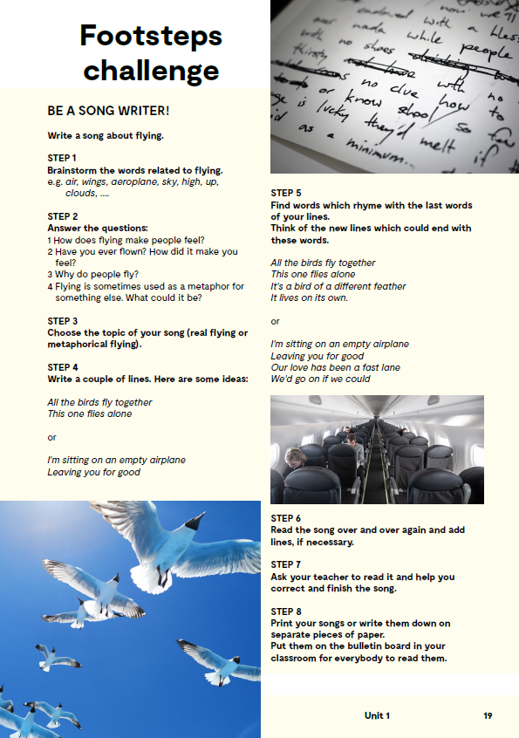
FOOTSTEPS CHALLENGE: Be a song writer! - Write a song about flying.
STEP 1; Brainstorm the words related to flying. e.g. air, wings, aeroplane, sky, high, up, clouds, ….
STEP 2; Answer the questions: 1 How does flying make people feel? 2 Have you ever flown? How did it make you feel? 3 Why do people fly? 4 Flying is sometimes used as a metaphor for something else. What could it be?
STEP 3; Choose the topic of your song (real flying or metaphorical flying).
STEP 4; Write a couple of lines. Here are some ideas: All the birds fly together This one flies alone or I'm sitting on an empty airplane Leaving you for good
STEP 5; Find words which rhyme with the last words of your lines. Think of the new lines which could end with these words. All the birds fly together This one flies alone It's a bird of a different feather It lives on its own. or I'm sitting on an empty airplane Leaving you for good Our love has been a fast lane We'd go on if we could
STEP 6; Read the song over and over again and add lines, if necessary.
STEP 7; Ask your teacher to read it and help you correct and finish the song.
STEP 8; Print your songs or write them down on separate pieces of paper. Put them on the bulletin board in your classroom for everybody to read them.

